Slide 1


STATE OF CALIFORNIA TITLE 24 LIGHTING CONTROLS ACCEPTANCE TESTING
Technician Skills & Responsibilities
Compliance Documentation
Installation Requirements
Acceptance Test Procedures
Training Program
Version 5.0
CALCTP
Images Courtesy of IBEW/NECA, California Lighting Technology Center, UC Davis, WattStopper

Slide 2

Impact of California’s
Energy Codes and Standards
The California Building Energy Efficiency and Appliance Efficiency standards have saved Californians more than $74 billion in electricity costs since 1975.
California’s per capita electricity use is about 40% lower than the U.S. national average.
These standards conserve electricity and natural gas, and reduce California’s need to build more power generation facilities. They also help protect the environment, and enhance U.S. energy independence.

Slide 3

What’s Changing and When?
The California Building Code Energy Efficiency section, Title 24, is updated on a 3 year cycle
The 2013 update takes effect January 1, 2014
New state regulations include greater efficiency standards for lighting and other systems
State certified testing of these systems, called Acceptance Testing (AT), is mandated
Images Courtesy of LUTRON (bottom left and right)

Slide 4

What Type of Project is Regulated?
The new building codes and standards regulate in commercial, non-residential, facilities
Newly constructed buildings
Alterations / Tenant Improvements (TIs)
Additions
Retrofits
Notes:
All newly constructed buildings (no previous occupancy)
Any addition
Any alteration that adds new equipment to an existing space.
Some lighting alterations (retrofits) are exempt. A retrofit that modifies less than 10% of the existing luminaires or ballasts, or any retrofit of < 40 ballasts or luminaires.
An addition is considered any change to a building that increases the unconditioned or conditioned floor area and volume. An addition is also any change that increases the illuminated area of an outdoor space. A alteration is any change to a buildings water-heating, space-conditioning, lighting or envelope system that does not result in an increase of building or outdoor illuminated area (i.e not an addition). Replacement of failed equipment (maintenance), if the equipment is regulated by Title 20 or Title 24, is considered an alteration for the purposes of standards compliance.

Slide 5
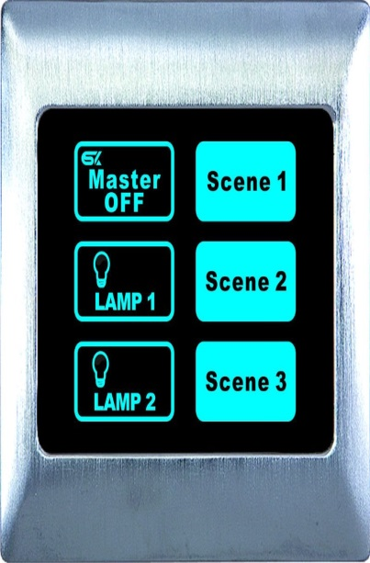
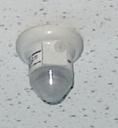
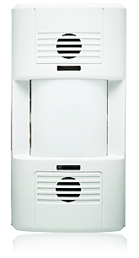
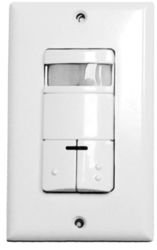
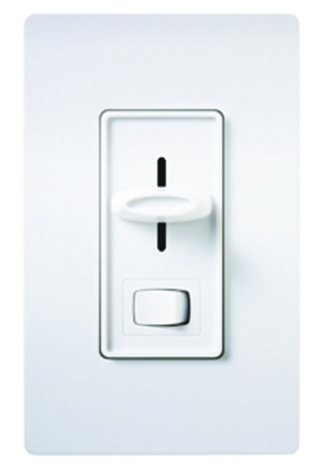
What Lighting Controls
Will be Regulated?
Any self-contained lighting control
Automatic Time-switch controls
Daylight controls and
photo controls
Dimmers
Occupant sensing devices
Images Courtesy of LUTRON (bottom left and right)
Notes:
Many types of lighting controls are regulated by Title 20 – Appliance Efficiency Standards. Any control integrated in a luminaire is regulated. The control must meet any device specific requirements noted in Title 20 and the manufacturer must provide instructions for installation and start-up calibrations. If an indicator light is used with these controls cannot consume more than 1 W of power. Device specific requirements exist for automatic time-switch controls including astronomical time switches, automatic daylighting controls, photo controls, dimmer controls and all types of occupant sensing devices.
To determine if a product meets Title 20 Appliance Efficiency Regulations, visit:
http://www.appliances.energy.ca.gov/QuickSearch.aspx and search for the product in the approved Appliance Database.

Slide 6
Acceptance Testing Overview
One piece of a multi-stage compliance program
Required of Building Owner for building occupancy
Verifies installation requirements are met
Ensures installed equipment and systems operate properly
Conducted by certified field technicians – if a contractor is not certified they will have to hire a certified contractor to verify their work
Required by the State of California
Notes:
Acceptance testing is one part of a multi-stage compliance program that ensures newly constructed buildings and new construction in existing buildings conforms to energy-efficiency standards contained in Title 24, Part 6 of the California Code of Regulations (CCR). Acceptance testing consists of a series of construction inspections and functional tests for different types of mechanical and electrical systems. These inspections and tests ensure that applicable systems are installed and operate correctly. Proper installation and commissioning is critical to realize energy savings from lighting controls. While the acceptance test process is a separate and independent process, Title 24 regulations now require that a Commissioning Report be completed and provided to the Building Owner. Part of this Commissioning Report includes reports on all functional performance tests completed as part of the acceptance test process. Therefore, the technician may be contracted to complete comprehensive test reports, including descriptions of all components, test methods, readings and adjustments, that go above and beyond the documentation requirements contained in the Certificate of Acceptance forms. More information on the Building Commissioning requirements are contained in Section 120.8 of the Standards.

Slide 7
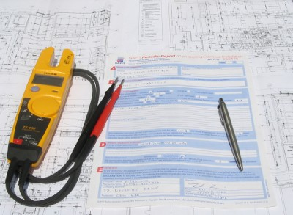
Buildings and Systems
Acceptance tests (AT) must be conducted on certain mechanical and lighting systems
Required for all newly constructed commercial buildings
Required on all additions
Required for all retrofits, renovations and tenant improvements >10% of the space
Notes:
Acceptance tests apply to most mechanical and electrical equipment and systems installed in new construction or retrofit applications. Tests exist for building envelope, ventilation systems, air conditions, heat pump systems, demand response control systems, and indoor and outdoor lighting controls, just to name a few.

Slide 8
Lighting Controls Acceptance Tests
Required of Building Owners Starting January 1, 2014 on:
Automatic Daylighting Controls
Automatic Time Switch Controls
Occupancy Sensors
Outdoor Lighting Shut-off Controls
Outdoor Motion Sensors
Automated Demand Response Controls (ADR) Mandatory for Alterations Over 50% of a Space
Notes:
There are six categories of lighting controls that require acceptance testing. These categories may change with each new iteration of the California Energy Code (Title 24, part 6). Current requirements go into effect on January 1, 2014. Any project issued a building permit on or after this date will be required to undergo these acceptance tests.

Slide 9
Certified Lighting Controls Acceptance Test Technician
The California Energy Commission (CEC) / Title 24 requires Certification to conduct lighting controls acceptance testing in California
The CEC also requires employers of acceptance testers to be certified
Contractors who are not certified to perform acceptance testing will have to arrange for an outside acceptance tester to certify their lighting controls work
Notes:
Beginning January 1, 2014, lighting controls acceptance test technicians (technicians) must be certified and registered with the State of California. Prior to this, acceptance tests could be conducted by anyone. In addition to certification requirements for technicians, technician employers must also be certified. Technicians and employers must complete training and pass an exam to gain certification.

Slide 10
Lighting Controls Acceptance Test Training
Must include both theoretical and hands-on training
Limited to participants with at least 3 years of verifiable professional lighting controls experience
Written and practical exams required for certification
CALCTP is a state approved AT certification provider
Curriculum developed by UC Davis California Lighting Technology Center (CLTC) under the supervision of the CA Energy Commission
Notes:
Nonresidential lighting controls acceptance test training and certification is prescribed in Section 10-103-A of the Standards. Training and certification requirements apply to test technicians, their employers and the Certification Providers that train and certify them. The training is limited to participants with at least 3 years of verifiable professional experience with lighting controls. Training participants must pass both a written and practical exam to gain certification. Certification must be periodically renewed to account for periodic changes in Title 24 requirements.
CALCTP received interim approval to serve as a Lighting Controls Acceptance Test Training Certification Provider due to its existing, comprehensive training program on advanced lighting controls. In addition to training on California acceptance test procedures and documentation, the CALCTP Acceptance Test Training requires training participants to complete the core CALCTP curriculum (excluding laboratory components) and all associated prerequisite requirements.

Slide 11
Lighting Controls Acceptance Test Training Classes
The Acceptance Testing Technical Training Class is 16 hours for those who have a CALCTP installer certificate. There is a pool of over 2,000 to draw from. (A longer class will be developed by UC Davis for others, late in 2013.)
The CALCTP installer certificate reduces the class time for Acceptance Testing Tech Training.
The Contractor class is 4 hours. Any currently licensed C-10 contractor may take the class with NO CALCTP Contractor certification or other prerequisites.

Slide 12
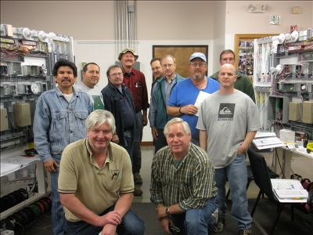
Lighting Controls Acceptance Test Training Schedule
At least 300 Acceptance Testers must be certified by 11/21 so JATC classes need to start in September
The support and encouragement of contractors, and IBEW-NECA leaders to schedule and fill the electrician classes is crucial
Contractor staff classes, too
Call or email your JATC now to provide estimated enrollment numbers

Slide 13
Upcoming Training
2 CALCTP-AT Train-the-Trainers for Instructors (to teach both technician, and contractor training)
  August 21-23 in Southern California
  August 27-29 in Northern California
Contact your local JATC to confirm they will be offering the CALCTP-AT Course in the Fall
The AT technical course is 16 hours.
(JATC’s are eligible to receive funds through an LMCC State Employment Training Panel (ETP) grant for which a minimum of 24 hours of training is needed for reimbursement. An extended 24 class is available.)
(The Contractor course is 4 hours.)

Slide 14
State of California Title 24
Lighting Controls Acceptance Testing Regulations
Thank you.

